Slide 1

Responsively Sizing Fonts

Slide 2
Two approaches to sizing fonts..
Using REM
Serving different pixel-sizes to different device sizes

Slide 3
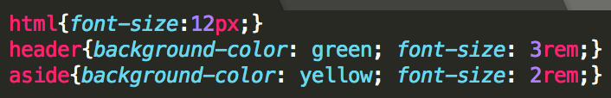
1. Using REM
For mobile layout:
html – website default size is set to 12px
header size is three times the default size - 36px
aside size is twice the default size - 24px

Slide 4
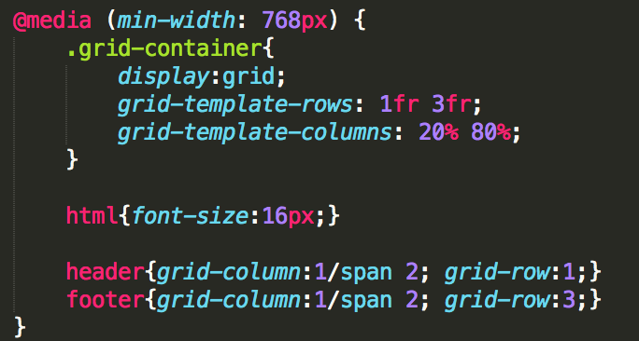
1. Using REM
For desktop layout:
Only attribute which needs to be added is html so default is now 16px
header & aside take 3rem and 2rem respectively

Slide 5
2. Serving different pixel sizes..
For mobile layout:
main size is 14px

Slide 6
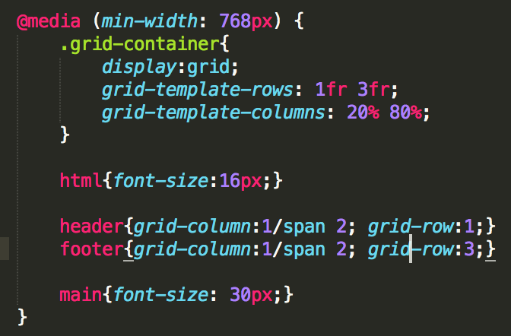
2. Serving different pixel sizes..
For desktop layout:
main size is 30px

Slide 7

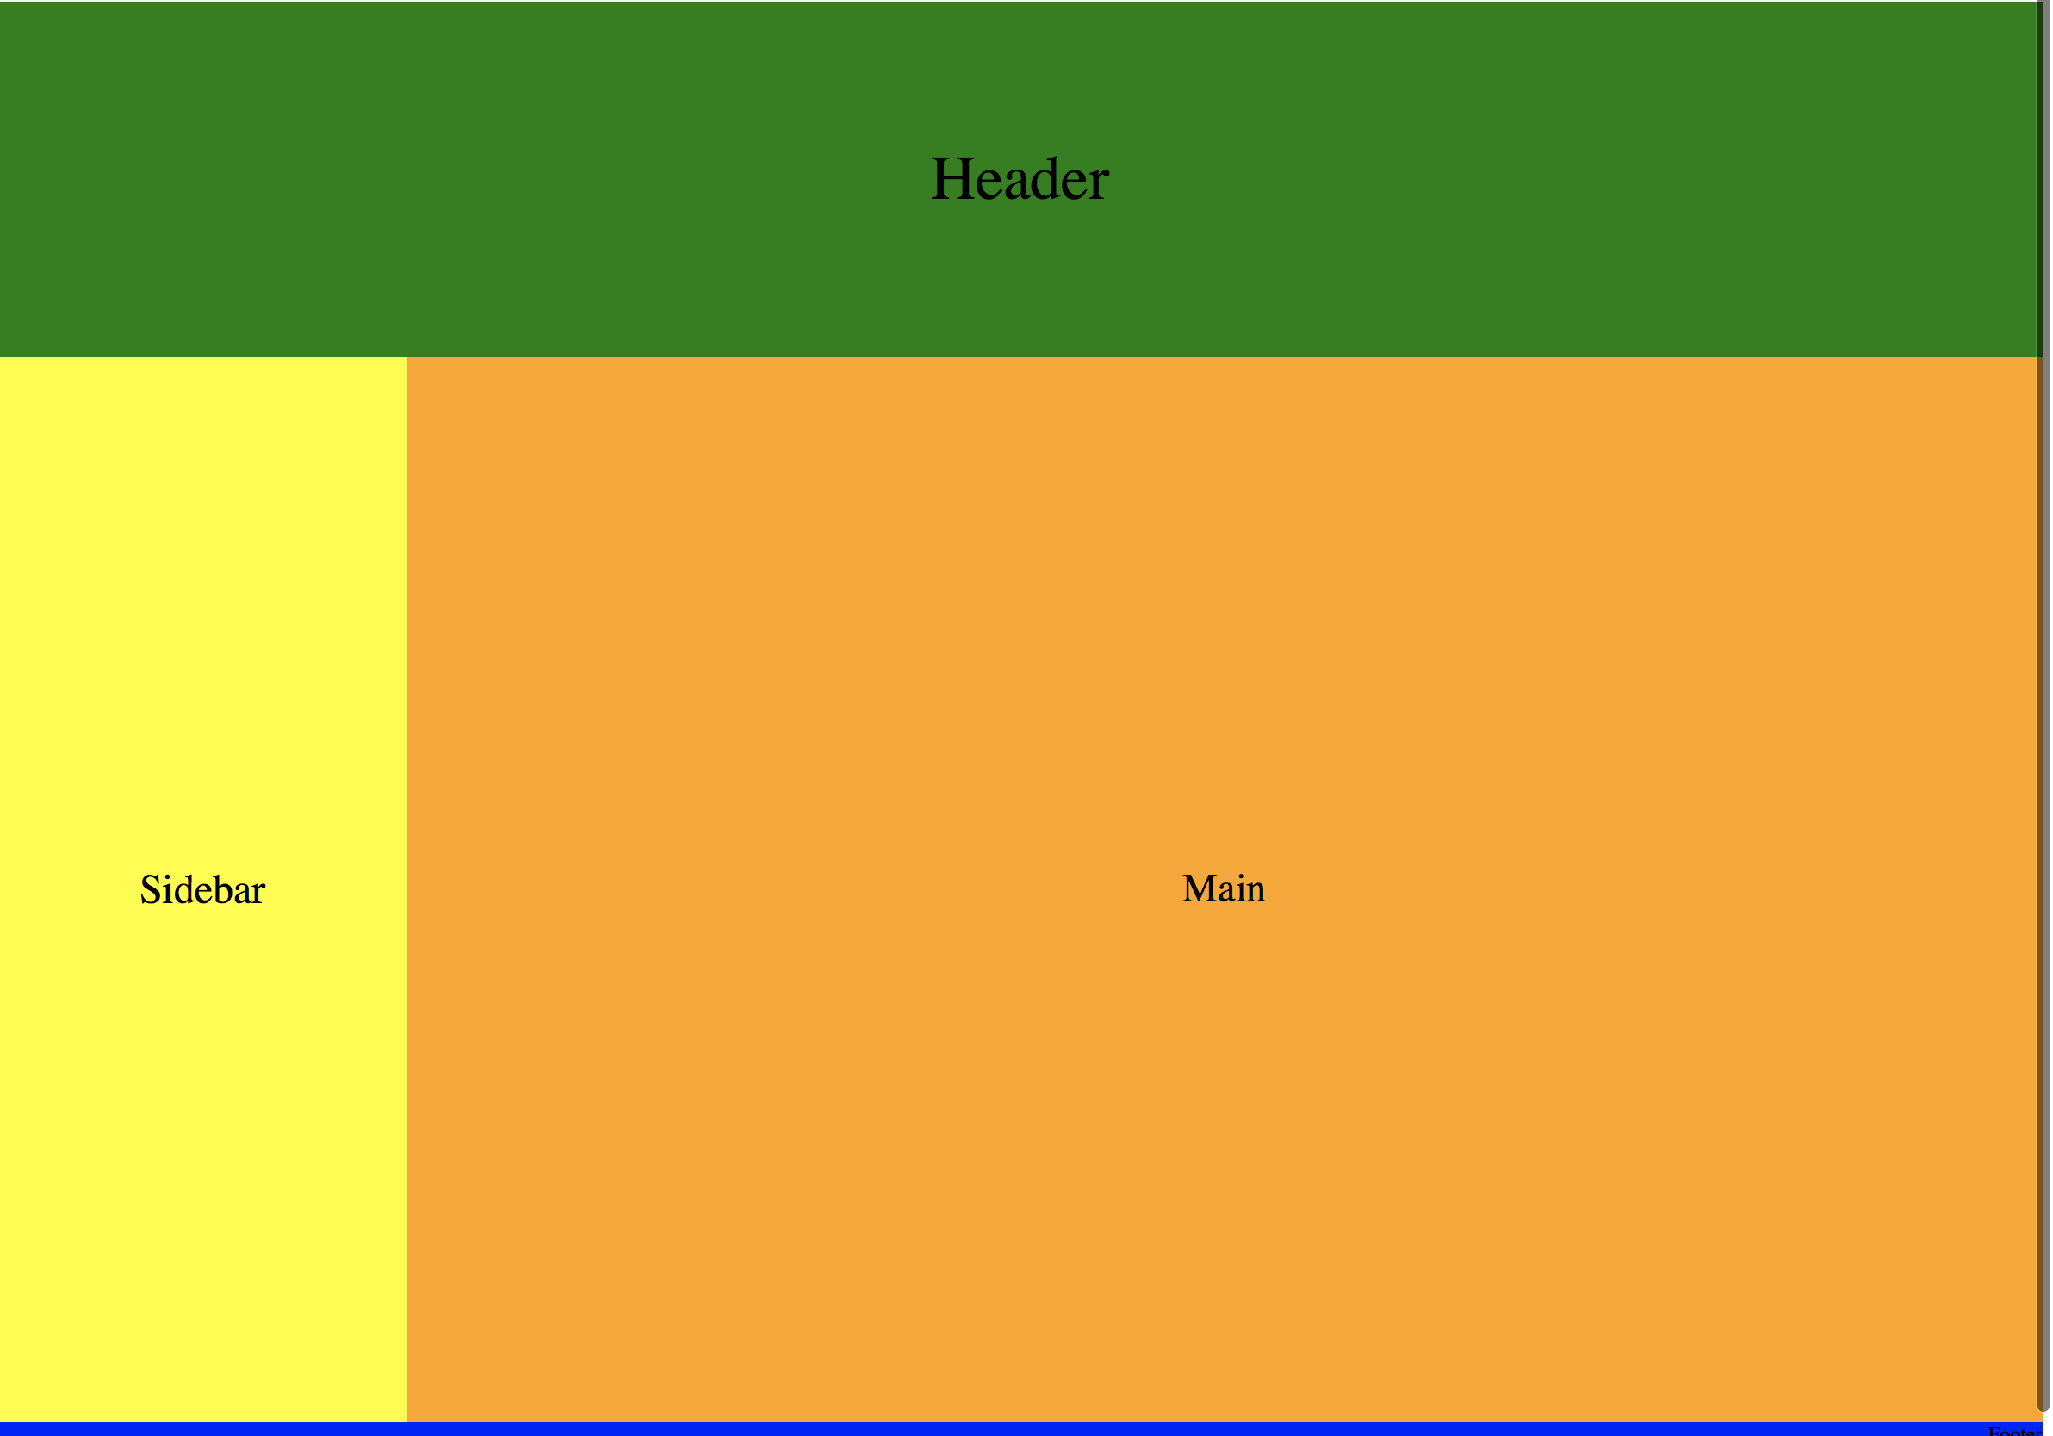
Mobile -> Desktop

